Slide 1


Graph Structure Learning via Lottery Hypothesis at Scale
ACML 2023
Yuxin Wang, Xiannian Hu*, Jiaqing Xie*, Zhangyue Yin*, Yunhua Zhou, Xuanjing Huang, Xipeng Qiu
November 12th, 2023

Slide 2
Terminology Review
Graph Neural Networks
Graph Structure Learning
Graph Attack / Defense
Lottery Ticket Hypothesis

Slide 3
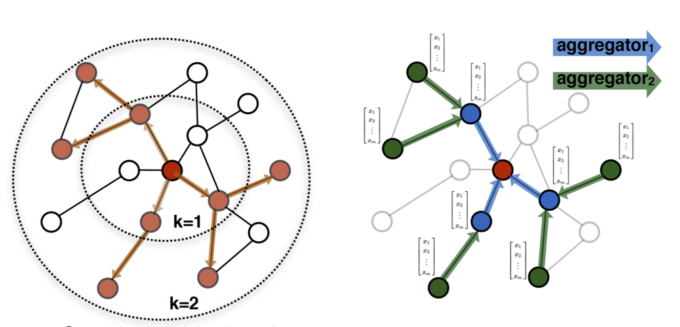
Graph Neural Networks
William L. et al. 2017

Slide 4
Graph Structure Learning
Main Idea: Learn Better Graph Structures
Methods:
Similarity Metrics
Graph Sparsification
Graph Regularization
Learning Paradigms
GNNBook Chapter 14

Slide 5
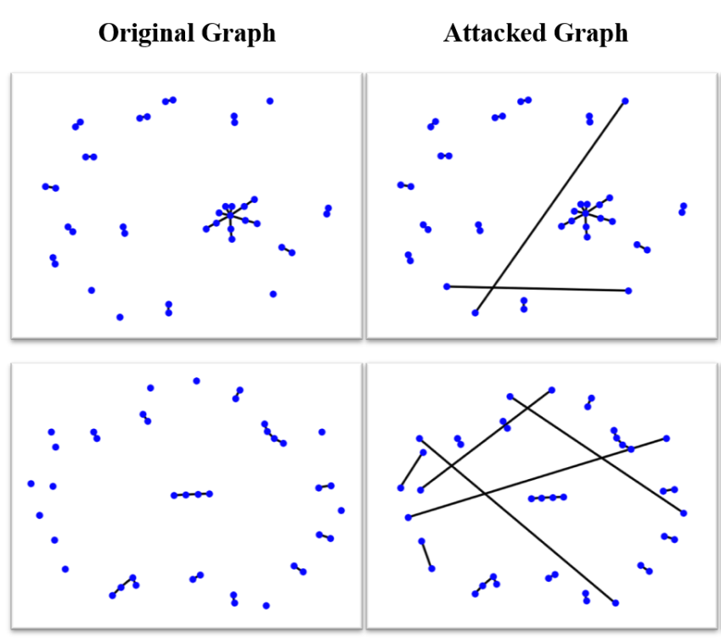
Graph(NN) Attack
Examples on Graph-level Attack:
Remove / Add nodes (Xu et al. 2019a, Wu et al. 2019)
An example on Model-level Attack:
Training surrogate models (Zugner et al. 2019)

Slide 6
Graph Defense
Graph purification: an example of graph defense
Previous graph purification are regularization methods
Disadvantage:
Lack of scalability (Chen et al. 2020a, Jin et al. 2020)
Top-k-features: not ensure dense graphs (Entezari et al. 2020)

Slide 7
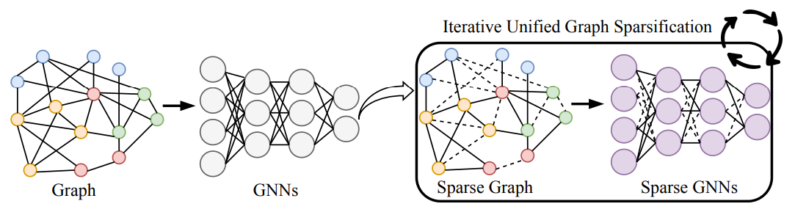
Lottery Ticket Hypothesis
DNN:
Find a pruned small sub-network that performed on par with the original large-scale network.
GNN:
Treat entries of adjacency matrix as parameters. Prune this matrix simultaneously with graph neural networks.
Chen et al. 2021

Slide 8
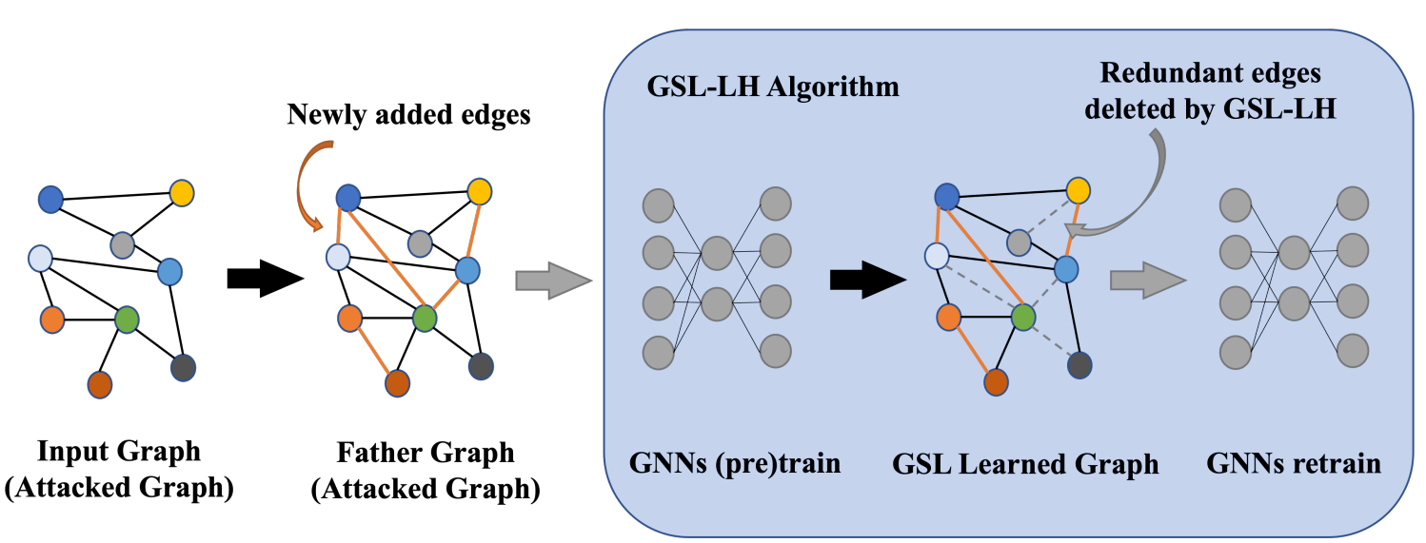
Graph Structure Learning with Lottery Ticket

Slide 9
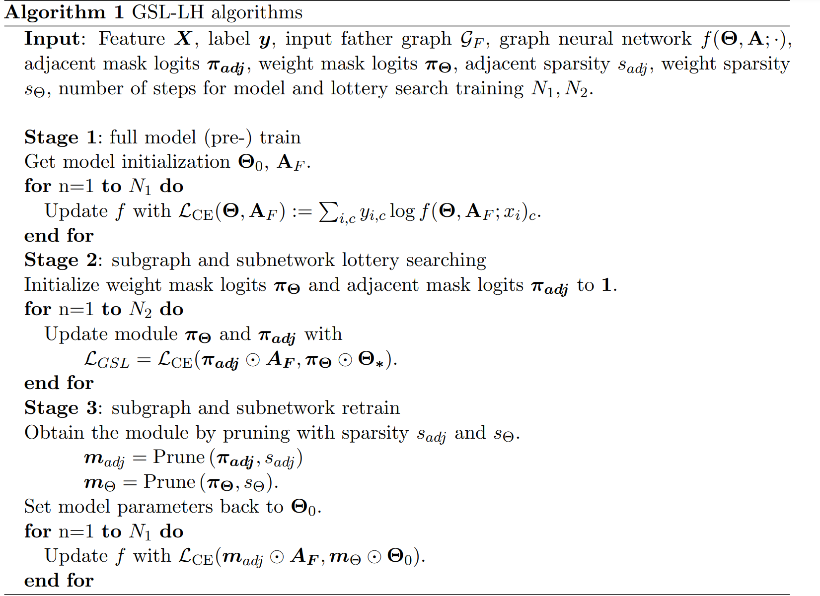
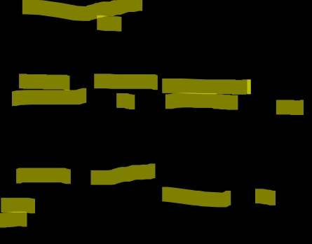
Graph Structure Learning with Lottery Ticket

Slide 10

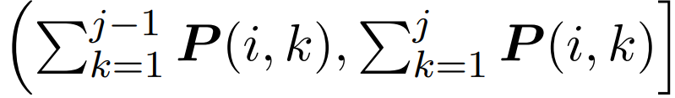
Sampling Methods
Random Sampling
Sample randomly from neighbour nodes
Feature Sampling
Sample by thresholding similarity of node pairs
Lottery Sampling
Obtain attention matrix P by normalizing inner products of node pairs
Randomly sample r. If r in , add j to neighbours of i

Slide 11
Time Complexity Analysis
Time Complexity for pruning and masking: O(E)
Training GNN: O(E) Wu et al. 2020
Overall O(E)
Better than graph decomposition
Example 1: spectral decomposition O(N^3) >> O(E)
Example 2: decomposition by cuts O(N^2 log N) >> O(E)

Slide 12
Baselines
GAT
GCN
RGCN
GCN-Jaccard
GCN-SVD
Pro-GNN-fs

Slide 13
Datasets
Cora
Cora-ML
Citeseer
PubMed
Arxiv

Slide 14
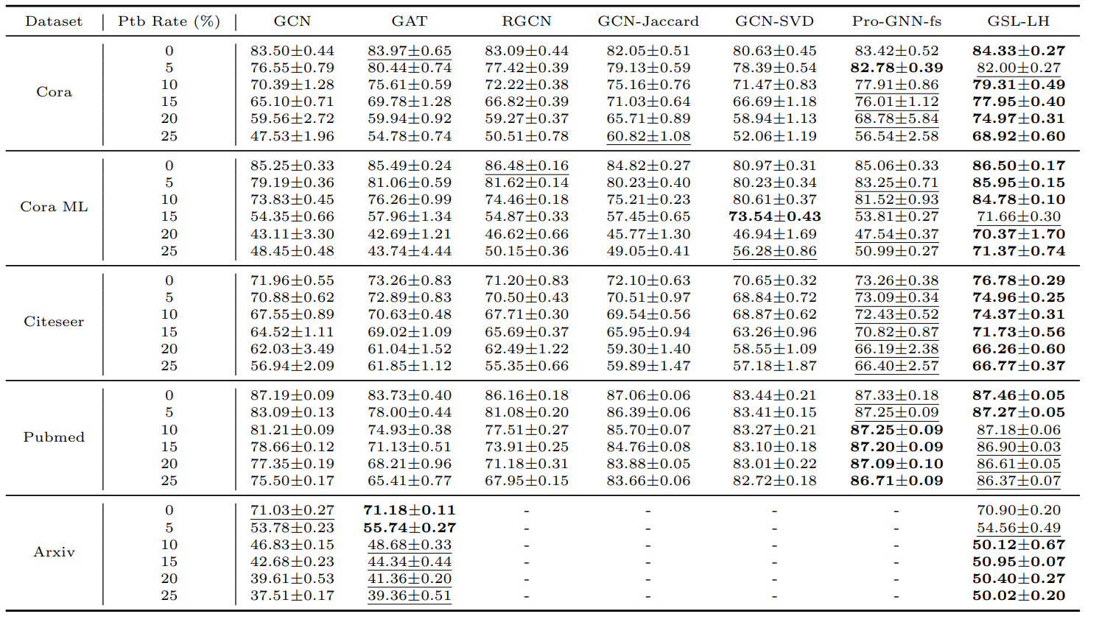
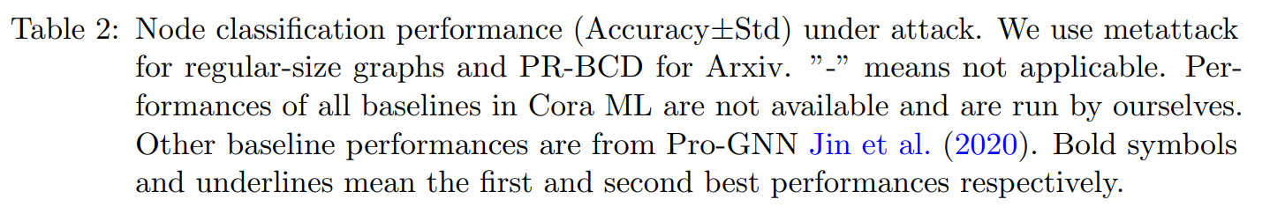
Results

Slide 15
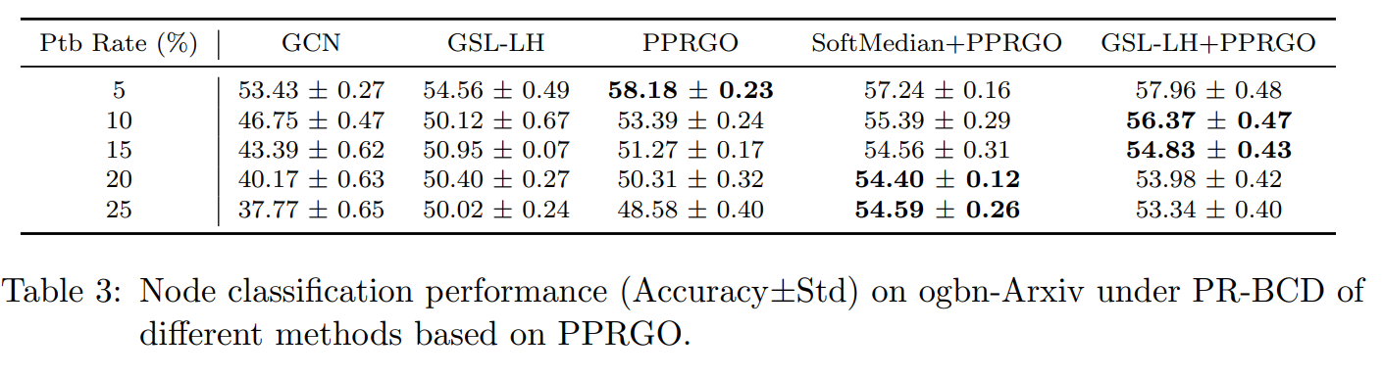
Results

Slide 16
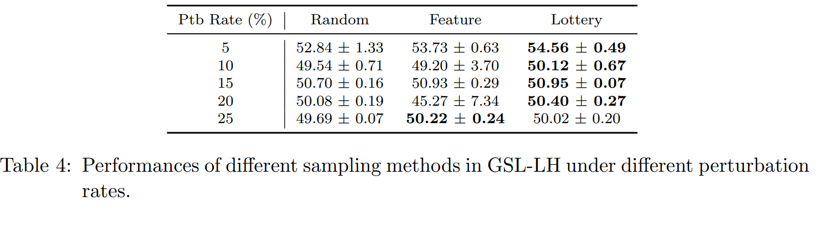
Ablation Study
Sampling

Slide 17
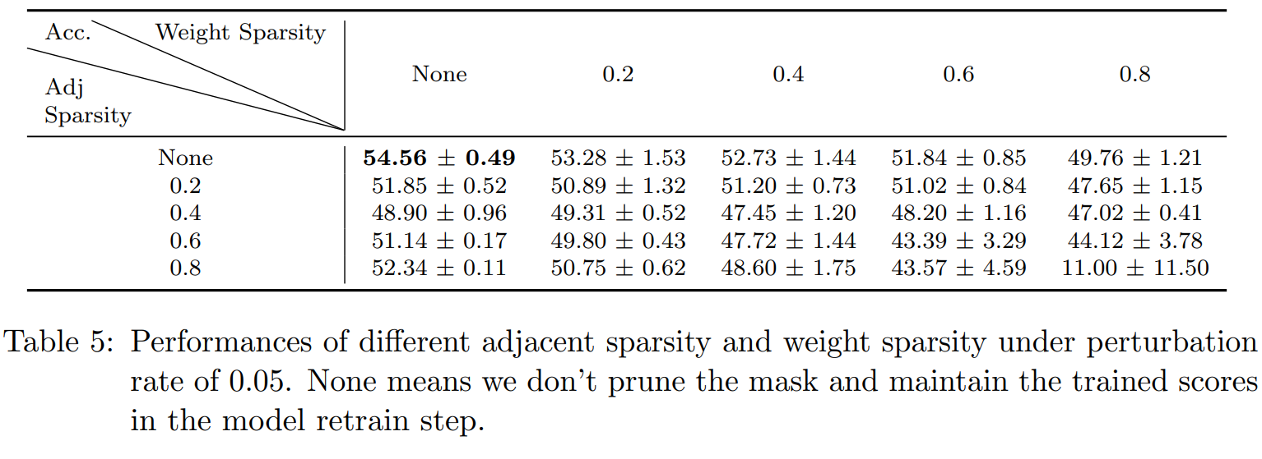
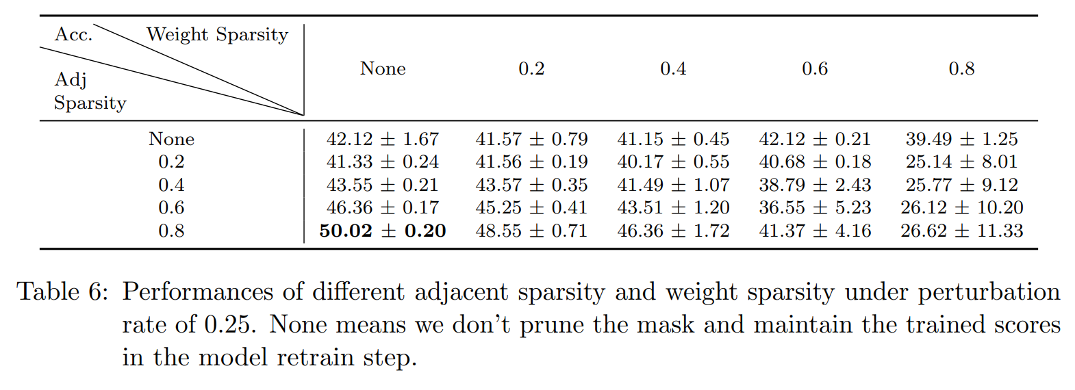
Ablation Study
Prune sparsity

Slide 18
Future works
Test with more recent advanced model (Dual Graph Lottery Ticket)
Kun et al. ICLR 2023
Test on more large-scale graph datasets

Slide 19
Resources
Code Repo: https://github.com/jiaqingxie/GSL-LH
Paper: Proceedings of Machine Learning Research 222, 2023

